Slide 1

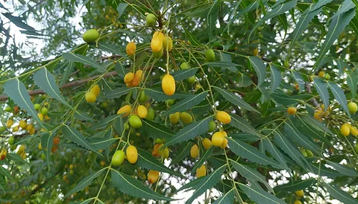
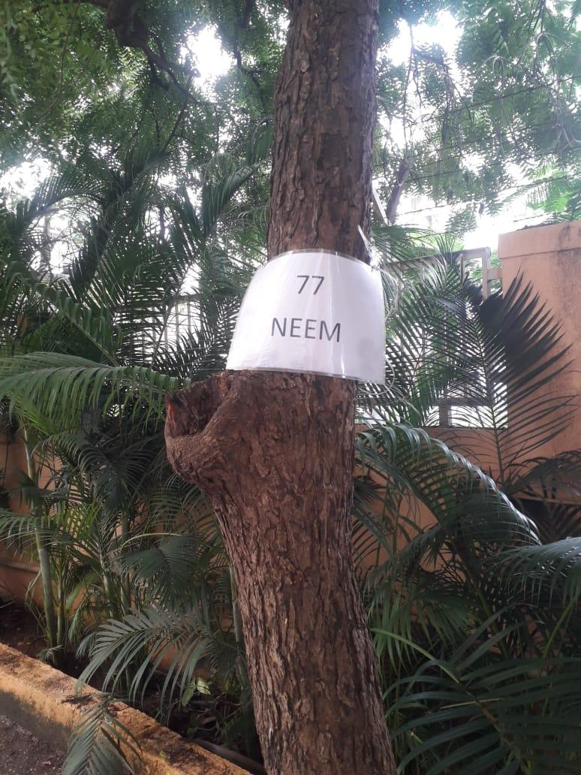
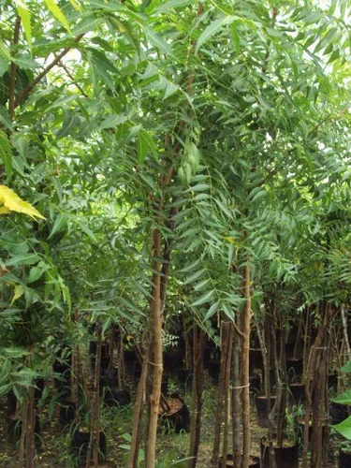
NEEM TREE
Near gate no.2 area AIS Campus, Wakad.

Slide 2
Common Name : Neem
Scientific Name : Azadirachta indica
Family : Meliaceae.
Habit : The tree naturally occurs in dry deciduous and thorn forests
Distribution : It is found in Sudan, Saudi Arabia, Mauritania, Somalia, Sierra Leone,
Malawi, Zimbabwe, Tanzania, Zanzibar and non-Sahelian areas of Guinea,
Nigeria, Ghana, Fiji, Thailand, Malaysia, Indonesia, the Philippines,
Australia, the Caribbean, Central and South America, USA, India and
Pakistan.

Slide 3
Description :
Height of Tree : About 12-15 m (39-49 ft).
Leaves : The opposite, pinnate leaves are 20–40 cm (8–16 in) long, with 20 to 30 medium to dark green leaflets about 3–8 cm (1.5–3.5 in) long. The terminal leaflet often is missing. The petioles are short.
Fruits: The fruit is a smooth (glabrous), olive-like drupe which varies in shape from elongate oval to nearly roundish, and when ripe is 14–28 mm by 10–15 mm. The fruit skin (exocarp) is thin and the bitter-sweet pulp (mesocarp) is yellowish-white and very fibrous. The mesocarp is 3–5 mm thick. The white, hard inner shell (endocarp) of the fruit encloses one, rarely two, or three, elongated seeds (kernels) having a brown seed coat.
Flowers: White and fragrant flowers are arranged in more-or-less drooping axillary panicles which are up to 25 cm (10 in) long. An individual flower is 5–6 mm long and 8–11 mm wide.

Slide 4
USES :
Fruits: The fruit is used for hemorrhoids, intestinal worms, urinary tract disorders, bloody nose, phlegm, eye disorders, diabetes, wounds, and leprosy.
Leaves: Neem leaf is used for leprosy, eye disorders, bloody nose, intestinal worms, stomach upset, loss of appetite, skin ulcers, diseases of the heart and blood vessels (cardiovascular disease), fever, diabetes, gum disease (gingivitis), and liver problems. The leaf is also used for birth control and to cause abortions.
Bark: Neem twigs are used for cough, asthma, hemorrhoids, intestinal worms, low sperm levels, urinary disorders, and diabetes. People in the tropics sometimes chew neem twigs instead of using toothbrushes, but this can cause illness; neem twigs are often contaminated with fungi within 2 weeks of harvest and should be avoided.
Seeds: The seed and seed oil are used for leprosy and intestinal worms. They are also used for birth control and to cause abortions.
Flower: The flower is used for reducing bile, controlling phlegm, and treating intestinal worms.

